Slide 1
The Bottleneck k-MST
Information Processing Letters 95(2005) 512-517
Abraham P. Punnen, Olena Chapovska
Presenter: Jun-Shong Lin
Date: May 11, 2006

Slide 2
Abstract
The k-MST is a well known NP-hard problem and several approximation algorithms exist to solve this problem with a guaranteed performance bound. A closely related problem, called the bottleneck k-MST (BMST(k)) can however be solved in O(mlog n) time on graph with n nodes and m edges. We propose two algorithms to solve BMST(k), one of complexity O(m + n log n) and the other of O(m) time. We also consider a generalization of BMST(k) which subsumes many bottleneck problems studied in the literature and show that this generalized problem can also be solved in O(m) time.

Slide 3
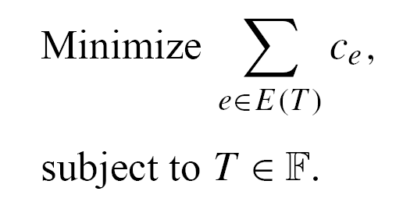
Introduction
k-MST problem (MST(k)) is to
be the family of all trees of G containing exactly k nodes.
If k = |V (G)|, MST(k) reduces to the well-known
minimum spanning tree problem which is solvable in
polynomial time.

Slide 4
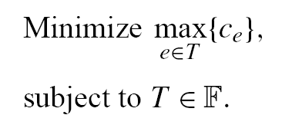
Introduction
The bottleneck version of MST(k) denoted (BMST(k)) which is defined as
Minimize

Slide 5
Introduction
If m = |E(G)| and n = |V (G)|,the binary search version of the threshold algorithm yields an O(mlog n) algorithm for BMST(k) and this is the best known time bound for the problem.

Slide 6
Introduction
For any minimum spanning tree of G,there exists a subtree which is an optimal solution to BMST(k). This leads to an O(m + n log n) algorithm to solve BMST(k).

Slide 7
The BMST(k)
Let S be a subset of V (G) and T be a spanning tree of G. A subtree T ' of T is said to cover S if S ⊆ V (T '). A subtree T '' of T that covers S is minimal, if there is no proper subtree T ''' of
T '' that covers S.

Slide 8

The BMST(k)
Let T ⁰ be a tree in G containing at least one edge and let T ∗ be a minimum spanning tree of G. Let be a minimal subtree of T ∗ that covers V (T ⁰).
G
T*
T⁰

Slide 9

The BMST(k)
Case 1:
T⁰
Ced
Satisfied!

Slide 10
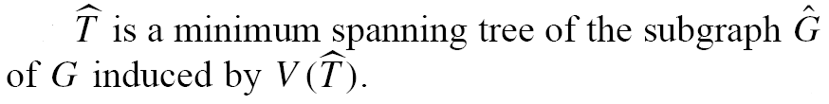


The BMST(k)
Case 2:
e_{γ}
T⁰
v
v
Ced
u
u
<1>
Satisfied!
<2>

Slide 11
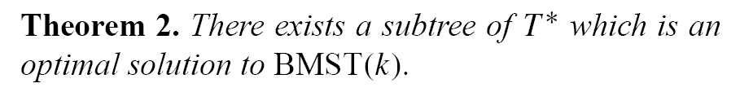



The BMST(k)
T⁰
T*
T**
Optimal!

Slide 12
The BMST(k)
Since a minimum spanning tree can be computed in O(m + n log n) time , an optimal solution to BMST(k) can be obtained in O(m + n log n) time by searching over the minimum spanning tree for an optimal subtree.

Slide 13
A linear time algorithm
We now show that without computing a minimum spanning tree, we can solve BMST(k) in O(m) time for any k.

Slide 14

A linear time algorithm
For any real number α
G
V₁
V₂
V₃
V₄
V₅
……..
………………………...
……..
………………………...
V?
………………………...
V_{p}
G(α)
E(G(α)) = { e ∈E(G) | c_{e} ≤ α}

Slide 15




A linear time algorithm
The collapsed graph :
<1>
u
V_{i}
<2>
:
( i , j )
v
V_{j}

Slide 16
A linear time algorithm
Let Gα₁,Gα₂, . . . , Gα_{p} be the connected components of G(α). If |V (Gα_{i} )| < k for all i, then the optimal objective function value of BMST(k) is grater than α.
Gα_{i}
>α
Gα_{j}

Slide 17
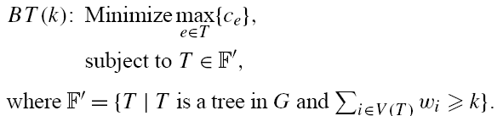
A linear time algorithm
For i ∈ V (G), let w_{i} ≥ 0 be a prescribed weight.

Slide 18
A linear time algorithm
If w_{i} = 1 for all i, then BT(k) reduces to BMST(k) since if the solution to BT(k) contains more than k nodes, we can trim the solution tree to obtain an optimal solution
to BMST(k).

Slide 19
A linear time algorithm
Let BOT(G, c,w, k) denotes the optimal objective function value of BT(k) on the graph G with edge cost function c and node weight function w.

Slide 20
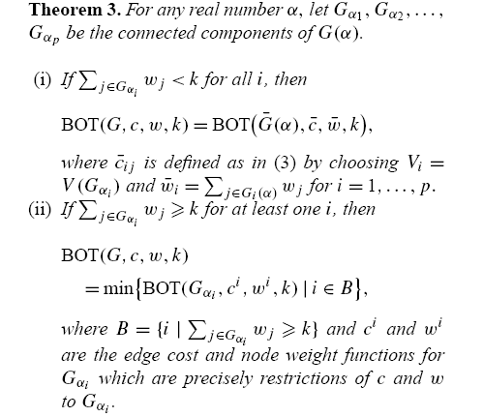
A linear time algorithm

Slide 21
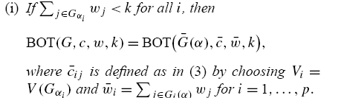

A linear time algorithm
Gα_{i}
The Optimal solution to BT(k)
must use an edge cost > α.

Slide 22
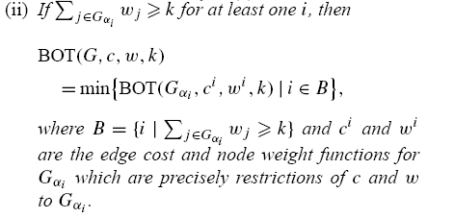
A linear time algorithm

Slide 23
A linear time algorithm
Based on Theorem 3, we now present our O(m) algorithm to solve BT(k). The algorithm uses Theorem 3 repeatedly by choosing α as the median of the edge costs of the graph under consideration.

Slide 24

A linear time algorithm
<1>The first part is iterative in nature and computes the optimal objective function value.
<2> Using this value, an optimal solution is constructed.

Slide 25
A linear time algorithm
Let us now look at the complexity of algorithm.
It is well known that the median of m numbers
can be identified in O(m) time. α is the median of the edge costs.

Slide 26


A linear time algorithm
It can be shown that an optimal objective function value can be obtained in O(m + m/2 + m/2² + ···) = O(m) time.

Slide 27
A linear time algorithm
By choosing w_{i} = 1 for all i ∈ V (G) algorithm
LINEAR solves BMST(k) in O(m) time.

